Slide 1



Department of Computer Science and Technology
Major Project Phase-I
Intelligent Student Support System Using Multilingual Conversational AI
TEAM N0 :- 24
Under the Supervision Prof. Prof Tanaya Bala Behera
1
Presented By: CHANDRAKANTH ENG22CS0040
CHETAN ENG22CS0041 CHINNIRATHOD ENG22CS0042 DARSHAN B ENG22CS0044

Slide 2
Overview
Abstract
Project Scope & Clarity
Requirement Specification & Validation
Innovation & Potential Impact
Literature Survey
High-Level Design
Demonstration
References
*
Dept of CSE., SOE-Dayananda Sagar University

Slide 3
Abstract
The current college web sites have information about the college, for instance, admissions, infrastructure, departments faculties, placements and soon, which needs to be searched by traversing through the time-consuming website.
There is a need for a College Enquiry CHATBOT which will provide a text-based user interface, allowing the user to type their queries regarding the college. These will be responded quickly a safe real person is talking to them.
➢Using this CHATBOT system, student candidates can find the information they need without waiting for the college/admission staff's answer.
*
Dept of CSE., SOE-Dayananda Sagar University

Slide 4
Project Scope & Clarity
Project Purpose & Objectives
Develop an NLP-powered College Enquiry Chatbot.
Provide instant, automated responses to college-related queries.
Reduce time and effort for students, parents, and staff.
Offer a conversational, human-like interaction experience.
Defined Scope Boundaries
Text-based chatbot for college enquiry.
NLP-based intent, entity, and context identification.
Sentiment analysis for empathetic replies.
Knowledge-base driven response generation.
Web deployment of chatbot.
*
Dept of CSE., SOE-Dayananda Sagar University
4 of 12

Slide 5
Project Scope & Clarity
Target Users / Beneficiaries
Students (current and prospective).
Parents and guardians.
College admission and administrative staff.
Faculty handling frequent repetitive queries.
Key Deliverables
AI-powered College Enquiry Chatbot (working prototype).
NLP module for intent/entity detection.
Knowledge base/database for college information.
Sentiment analysis integration.
System documentation and project report.
UML diagrams, architecture, and flowcharts.
(#) of 12

Slide 6
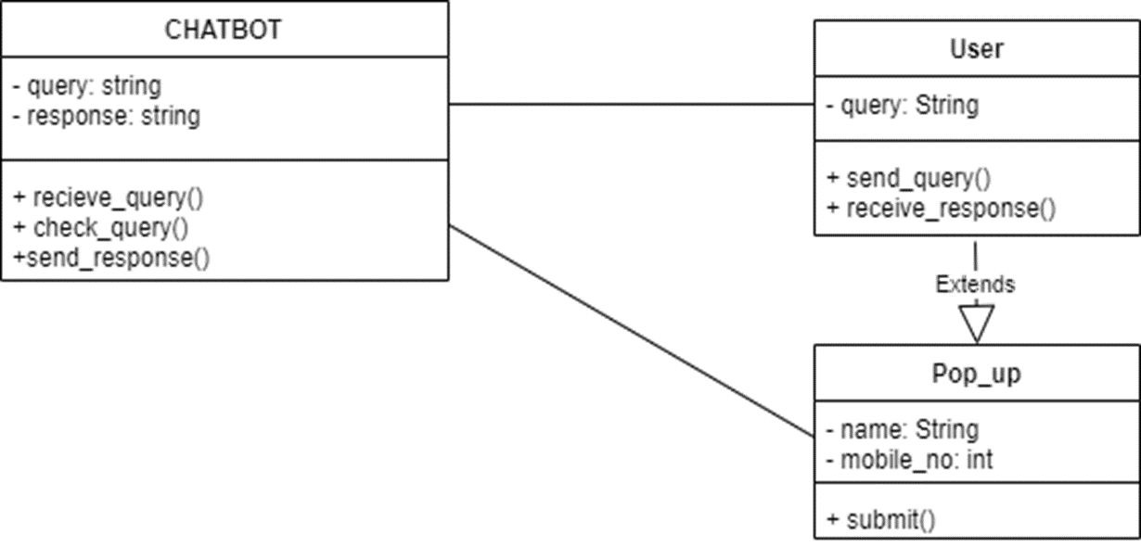
UML Diagram
(#) of 12

Slide 7
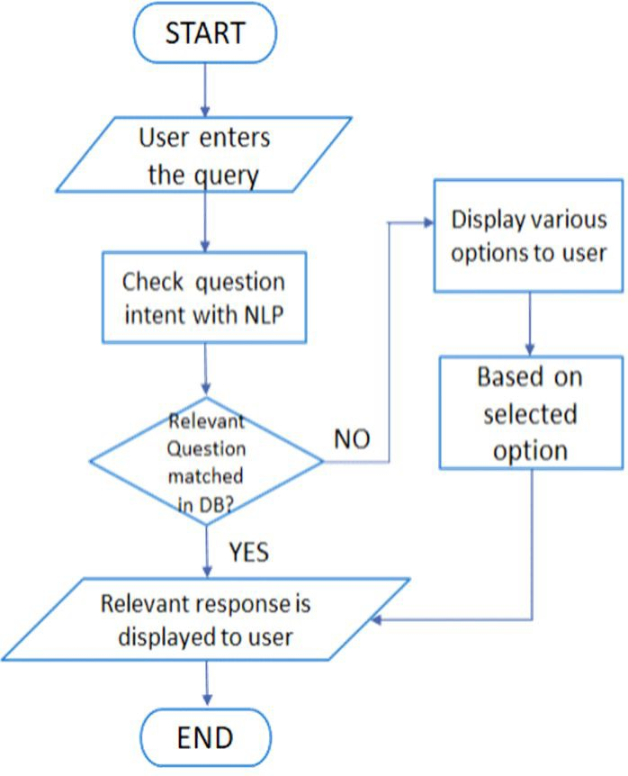
Flow chart
(#) of 12

Slide 8
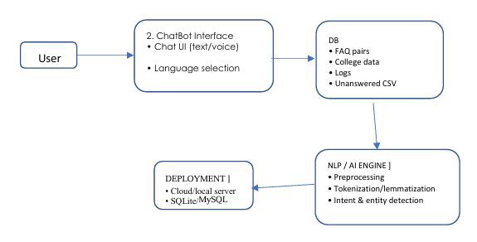
System Architecture
(#) of 12

Slide 9
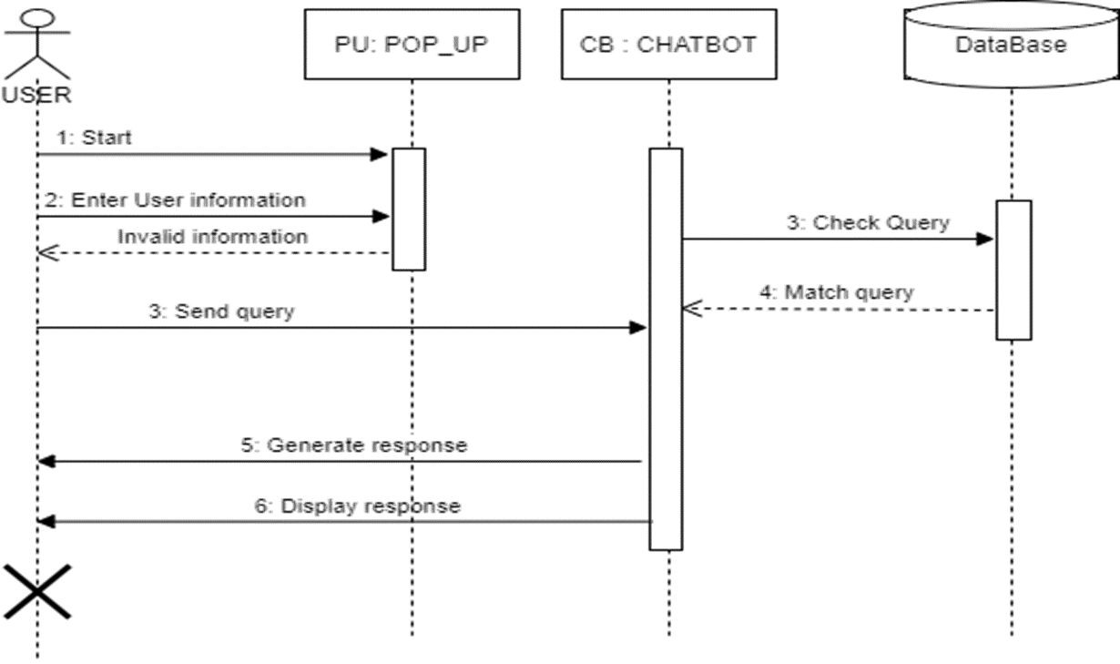
System Architecture
(#) of 12

Slide 10
Requirement Specification & Validation
Technologies / Tools Used
Windows 7,8,10/Mac OS high Sierra/Linux 16
Python 3.8
Visual Studio Code
Natural Language Processing
The most basic and useful technique in NLP is extracting the entities
in the text.
o Text Summarization.
(#) of 12

Slide 11
Requirement Specification & Validation
System Requirements
Software Requirement
Windows 7,8,10/Mac OS high Sierra/Linux 16
Python 3.8
Visual Studio Code
Hardware Requirement
Desktop or Laptop
4GB RAM , 128GBHDD
» Python 3.8
*
Dept of CSE., SOE-Dayananda Sagar University
11 of 12

Slide 12
Requirement Specification & Validation
System Implementation Plan
Front end
HTML
CSS
Back end
Python
SQLite
Framework
Flask
Packages & templates
NLP(nltk)
Scikit-learn
Jinja templates
(#) of 12

Slide 13
Requirement Specification & Validation
Analysis Models
Modules
Module 1: Dataset preprocessing Module 2: Fitting NLP model Module 3: Front end design
Module 4: Front end - back end connectivity
Module 5: Handling unanswered questions
(#) of 12

Slide 14
Algorithm
Algorithm used is NLP i.e. Natural Language Processing. In that tokenization, lemmatization and stop words removal techniques are used.
Step 1: Start.
Step 2: Get the input query from the user.
Step 3: The query is pre-processed. E.g. suppose there is this query “what are the project domains for CSE fourth year major projects.” So, we are going to remove these stop words like “are”, “the” using pre-processing technique.
Step 4: Fetch the remaining keywords from the query.
Step 5: Match the fetched keywords with the keywords in Knowledge base, and provide an appropriate response.

Slide 15
Step 6: Further the Database module is used to call proper services using entity information to find proper data.
Step 7: The keywords will be matched with the help of keyword matching algorithm.
Step 8: It returns the query response to the bot.
Step 9: Chat-bot packages the data into proper response for display by the client.
Step 10: Exit

Slide 16
Innovation & Potential Impact
Combines NLP + rule-based knowledge matching for reliability
Reduces repetitive human effort through automation
Potential Societal Impact
Reduces workload on faculty and administrative teams
Ensures students/parents get 24×7 accurate information
Improves accessibility for students from rural/remote areas
Enhances transparency in admissions and academic processes
Scalability & Future Scope
Can be extended to voice-based chatbot
Can integrate with student portals, ERP systems, placement cell, etc.
Can be deployed across multiple colleges or universities Can store user patterns to provide personalized responses
Supports multilingual expansion
* Dept of CSE., SOE-Dayananda Sagar University
14 of 12

Slide 17
Literature Survey
Author’s Name/ Paper Title | Conference/Jo urnal Name and year | Technology/ Design | Results shared by author | What you infer
Sahil Baviskar et al. (2024) — “EduAssist: Chatbot for Student Admission Queries” | IJRASET, Volume 12, Issue 11, 2024 | -HuggingFace Models | only one language responses | Illustrates next-generation chatbots using RAG + vector databases. Shows how
 |  |  |  | advanced retrieval and
 |  |  |  | LLMs significantly
 |  |  |  | improve accuracy.
 |  |  |  | Indicates future scope for
 |  |  |  | your chatbot to adopt
 |  |  |  | RAG for richer, more
 |  |  |  | intelligent responses.
Pooja Kandari et al. | Asian JouIRJET, Volume | NLP (HuggingFace | Flask backend. | Uses traditional NLP
(2025) — “Chatbot for | 12, Issue 01, 2025rnal of | Transformers) | MySQL DB | (TF-IDF) showing
Student Enquiry” | Research in Computer |  |  | simpler but effective
 | Science, Volume 18(6), |  |  | approaches. Reinforces
 | 2025 |  |  | how your project benefits
 |  |  |  | from more advanced
 |  |  |  | NLP (intent/entity
 |  |  |  | detection) for better
 |  |  |  | accuracy and interaction
 |  |  |  | quality.
(#) of 12

Slide 18
Literature Survey
Author’s Name/ Paper Title | Conference/Jo urnal Name and year | Technology/ Design | Results shared by author | What you infer
Michael Mauldin (1994) | Proceedings of the | Early conversational | Rule-based bots can | Modern NLP & ML
— “ChatterBots, | Eleventh National | agent “Julia” | mimic simple human-like | (used in your project)
TinyMUDs, and the | Conference on Artificial |  | conversation | solve many of these
Turing Test: Entering the | Intelligence (AAAI), |  |  | limitations
Loebner Prize | 1994
Competition”
S. Oviyan, V. Jaya | Asian Journal of | NLP (HuggingFace | 92% response accuracy | - Very advanced chatbot
Prakash, S. Praveen | Research in Computer | Transformers) | across 50+ queries | (multimodal: text, voice,
Kumar, R. Vishva & V. | Science, Volume 18(6), |  | - 85% accuracy in | image)
Thiruppathy Kesavan — | 2025 |  | identifying college
“AI Powered Chatbot for |  |  | buildings from images
College Information and |  |  | - 65% reduction in time
Student Support |  |  | to get information
*
Dept of CSE., SOE-Dayananda Sagar University

Slide 19
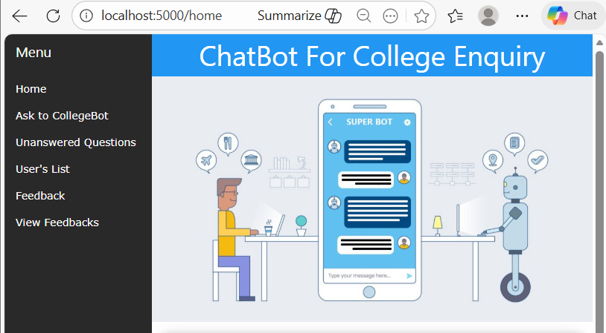
Demonstration

Slide 20
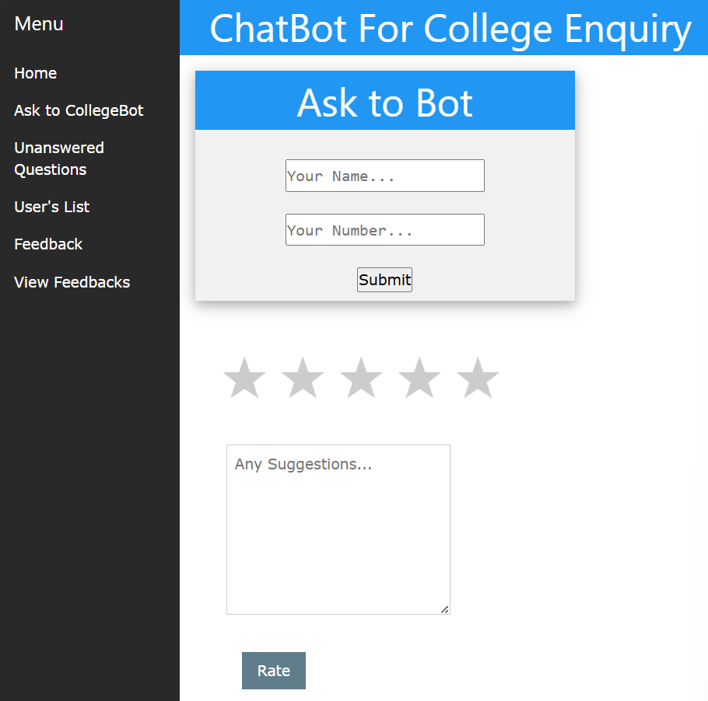

Slide 21
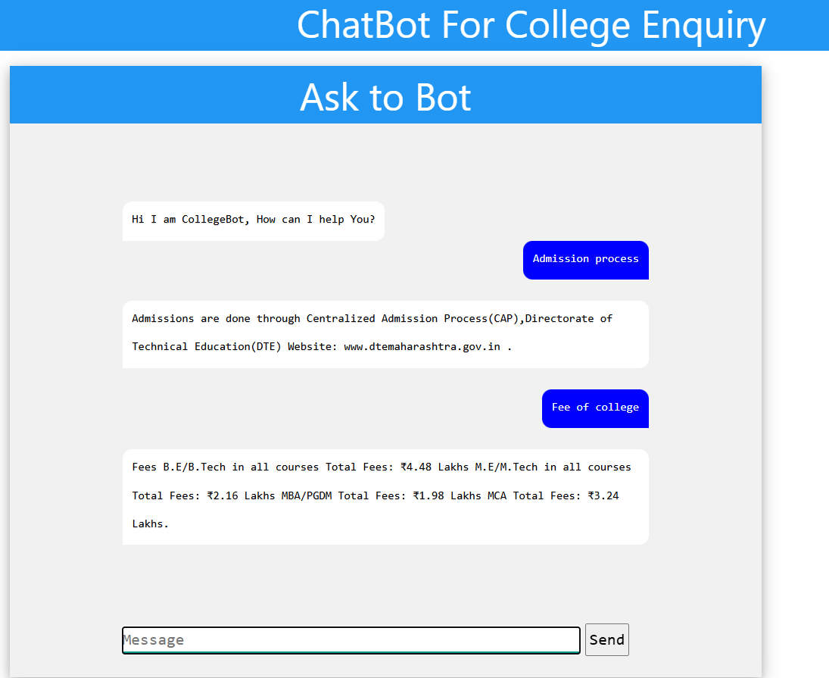

Slide 22
References
[1] M. Mauldin, “ChatterBots, TinyMUDs, and the Turing Test: Entering the Loebner Prize Competition,”
Proceedings of the Eleventh National Conference on Artificial Intelligence (AAAI), 1994.
[2] S. Oviyan, V. J. Prakash, S. P. Kumar, R. Vishva and V. T. Kesavan, “AI Powered Chatbot for College
Information and Student Support,” Asian Journal of Research in Computer Science, vol. 18, no. 6, pp. 1–12, 2025.
[3] S. G. Kotambe, A. S. Lalage, P. B. Shirke, A. A. Taralkar and G. V. Purohit, “AI–Powered Student
Assistance Chatbot,” International Journal of Creative Research Thoughts (IJCRT), vol. 12, no. 11, pp. 253–256, 2024.
[4] P. Kandari, R. S., S. K., S. Sultan L. B., and S. S. A., “Chatbot for Student Enquiry,” International Research Journal of Engineering and Technology (IRJET), vol. 12, no. 01, pp. 400–403, Jan. 2025.
[5] S. Baviskar, K. Deshmukh, L. Deshmukh, N. Kothawade and M. Mali, “EduAssist: Chatbot for Student
Admission Queries,” International Journal for Research in Applied Science & Engineering Technology (IJRASET), vol. 12, no. 11, pp. 1119–1122, Nov. 2024.
*
Dept of CSE., SOE-Dayananda Sagar University
19 of 12

